Slide 1
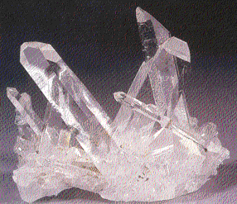
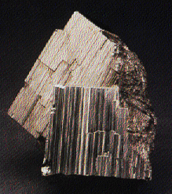
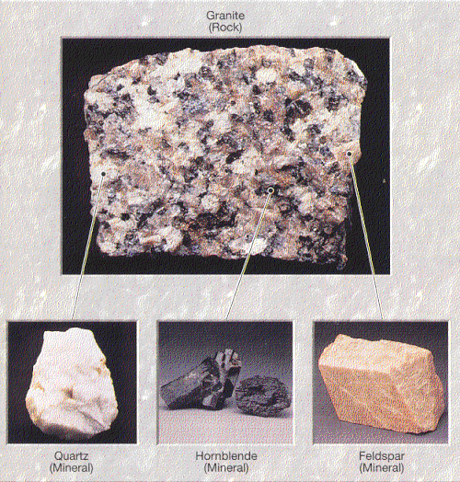
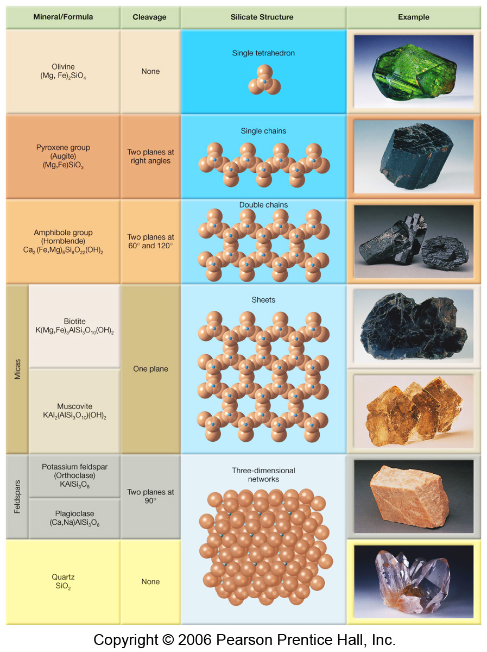
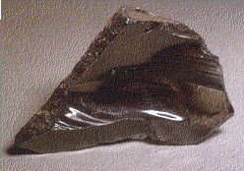
CHAPTER 2
Matter and Minerals
Part Two

Slide 2
How Do Mineralogists Identify Minerals?
They can examine physical properties of the unknown
mineral to help in determining the mineral’s identity.
For slides #3 through #7, several physical properties of
minerals will be described along with examples.
When you have finished watching the video below
on mineral identification and reading the slides, you
should be able to complete the assignment on mineral
identification.
Click on Dot For Video:
“How to identify a mineral”

Slide 3
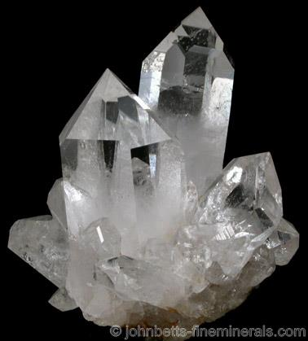
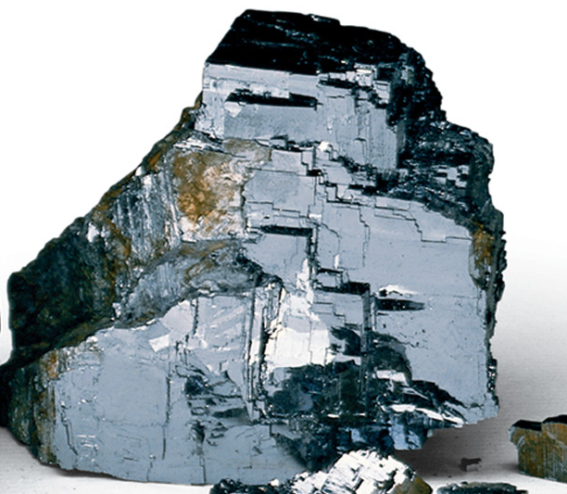
SOME PHYSICAL PROPERTIES
OF MINERALS
Crystal Shape or Habit – Describes the shape of the crystal due to the internal arrangement of the atoms in that crystal.
Quartz
Luster – The appearance of the mineral’s surface as it reflects light.
Types:
Metallic
Nonmetallic – glassy, dull
Galena – metallic luster

Slide 4
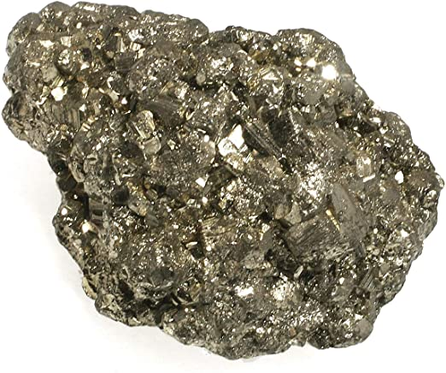
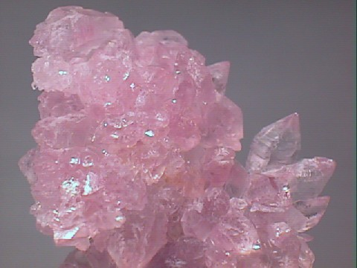
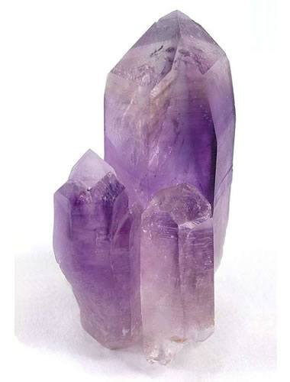
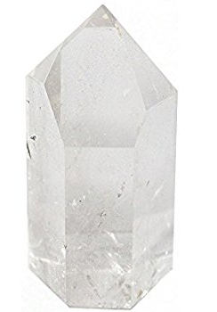
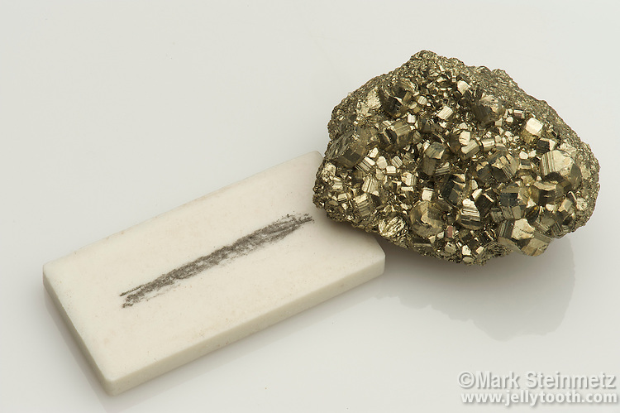
MORE PHYSICAL PROPERTIES
OF MINERALS
Color – Most obvious characteristic, but it is the least reliable property. Some minerals have a variety of colors.
Pyrite (fool’s gold)
Quartz
Rose Quartz
Amethyst
Streak - The color of the mineral in its powdered form.
Pyrite has a dark gray streak.

Slide 5
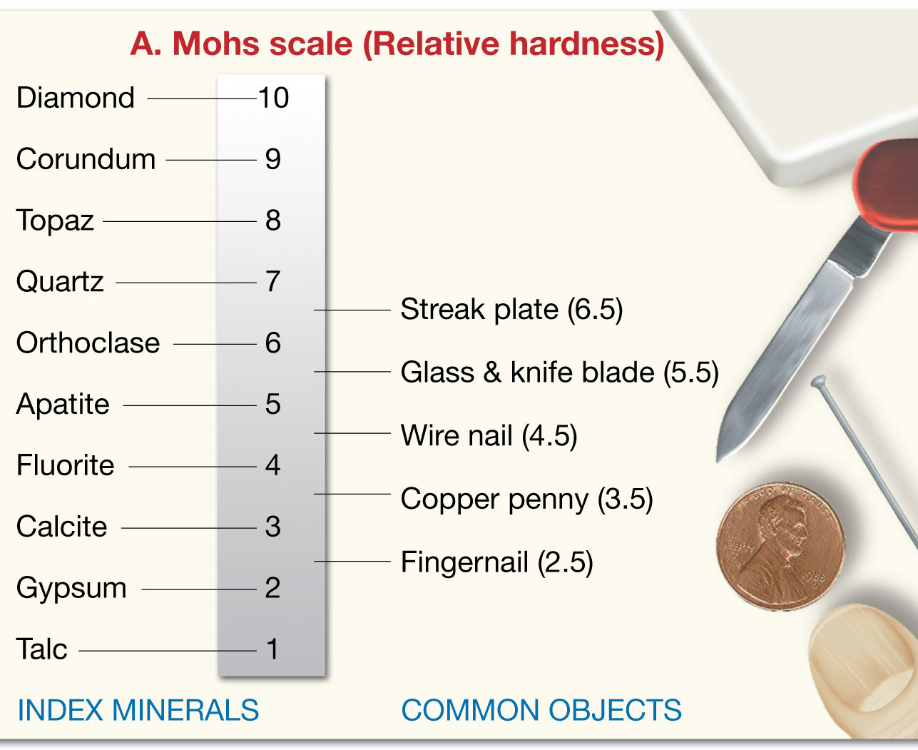
MORE PHYSICAL PROPERTIES
OF MINERALS
Hardness – Ability of a mineral to resist being
scratched.
Mohs Hardness Scale
It was developed by Friedrich Mohs in 1812
Whichever mineral scratches the other is harder, and if both scratch each other they are both the same hardness.
*Talc is softest at #1 *Diamond is hardest at #10.

Slide 6
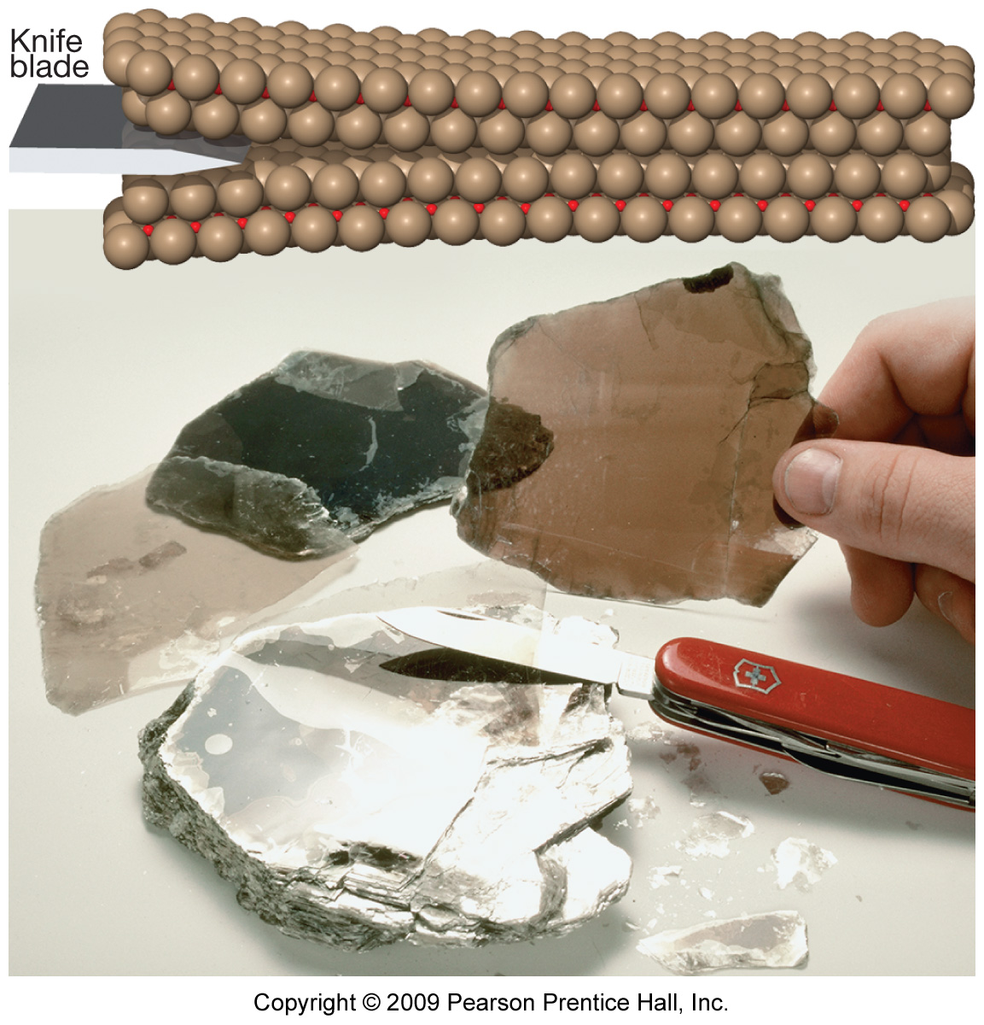
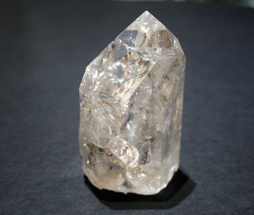
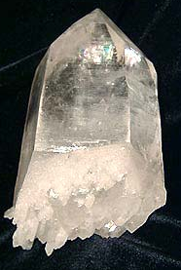
MORE PHYSICAL PROPERTIES
OF MINERALS
Cleavage - The tendency of a mineral to break along surfaces of weak bonding. Fragments have same general shape.
Mica
Fracture – Uneven surfaces are produced when the mineral breaks.
Quartz

Slide 7
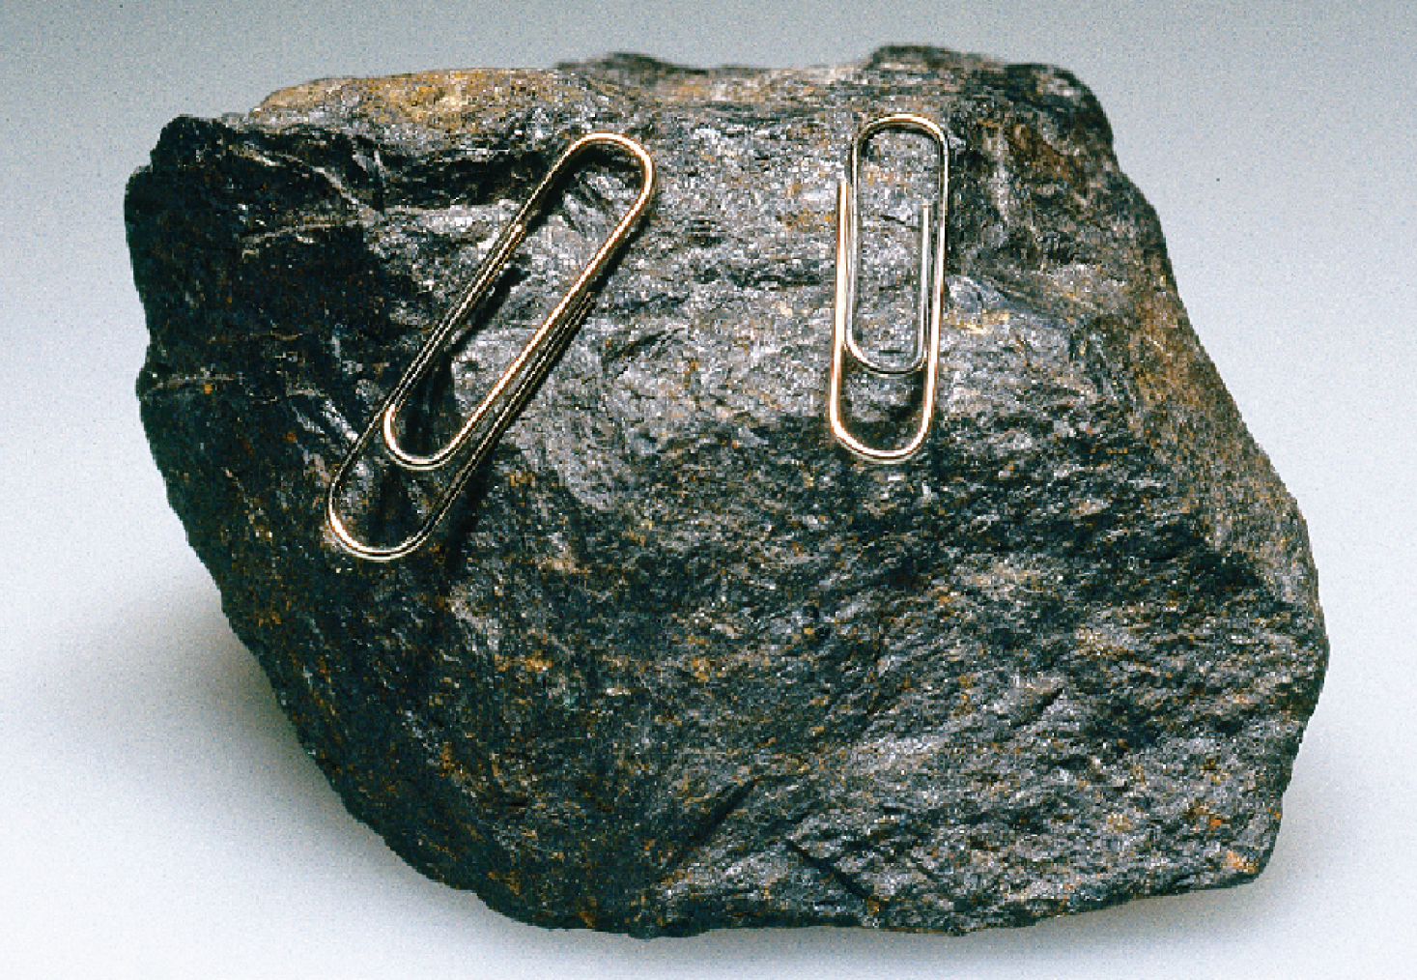
MORE PHYSICAL PROPERTIES
OF MINERALS
Specific Gravity – Compares the density of a
mineral to the density of water.
The specific gravity of minerals averages between 2 and 3. That means the average density of minerals is between two and three times greater
than the density of water.
Magnetism – Some minerals
have magnetic properties.
Magnetite

